Slide 1
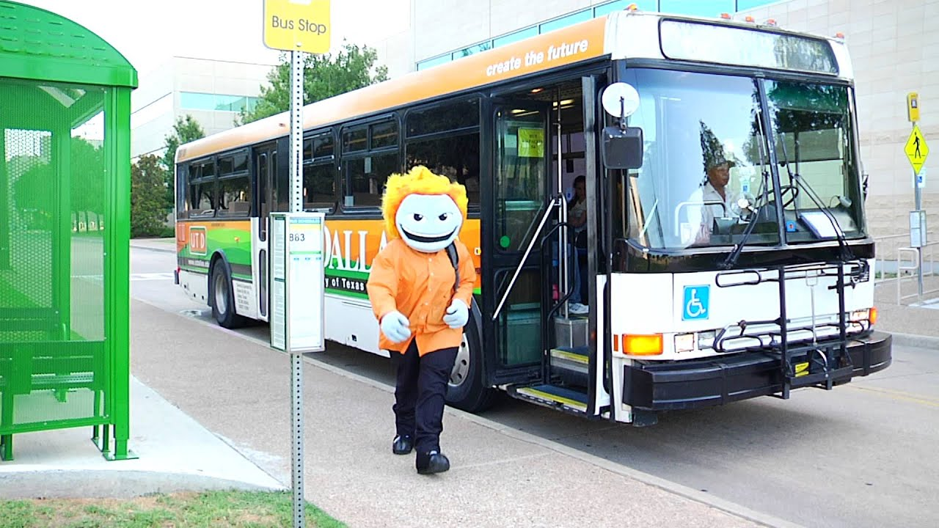
Group 4: Ayush Singh, Nishi Shah, Prasanth Ramanathan, Shruthi Gopal, Surya Varma
“Comet Transit”

Slide 2
Contents
Current System: Problem Statement
Proposed System Enhancements
Context Diagram
Interface
Class Diagram
Future Enhancements

Slide 3
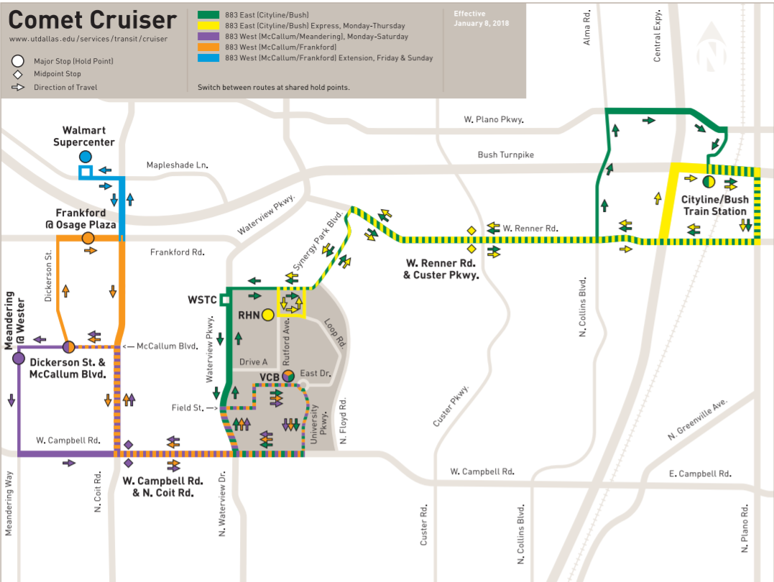

Slide 4
Current System: Problem Statement
UTD DART/Comet Cruisers are often overcrowded resulting in longer wait time for students.
During peak hours, buses get full, due to which some students end up getting delayed for classes.
UTD Mobile App allows students to track bus location. However, the system lacks a feature that can check if the bus is fully or partially filled.
A customized student transit feature that can help students plan on which bus to take for a particular day is currently missing.
At present, the DART officials do not have access to the count of people left to be picked so as to deploy a new bus/van.

Slide 5
Proposed System Enhancements
Attach sensors to the bus that can report real-time occupancy data to the UTD System.
Color coding feature can help students to decide whether to board the current bus or not.
Map student class schedule to the bus schedule. Based on the prediction, alert/notify students with an ideal boarding time.
Introduce a vehicle deployment system that can cater to the left-out students with a new bus/van.

Slide 6
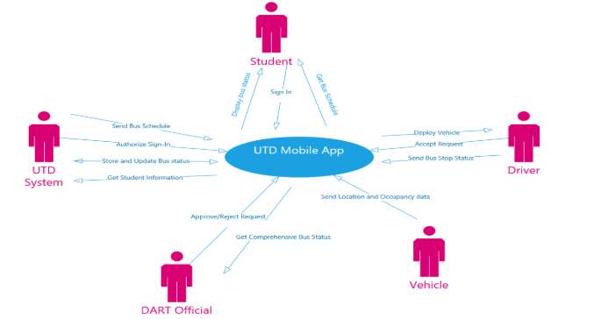
Context Diagram

Slide 7
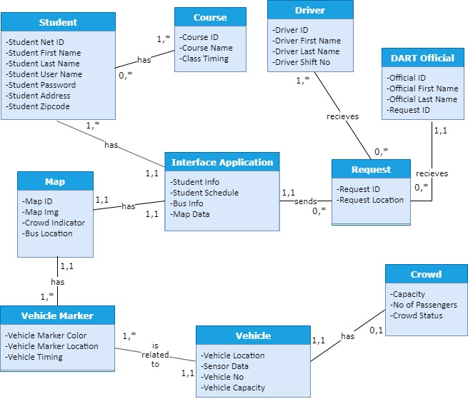
Class Diagram

Slide 8
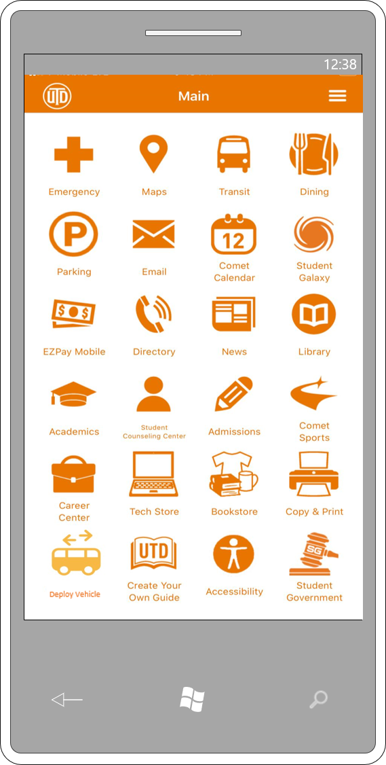
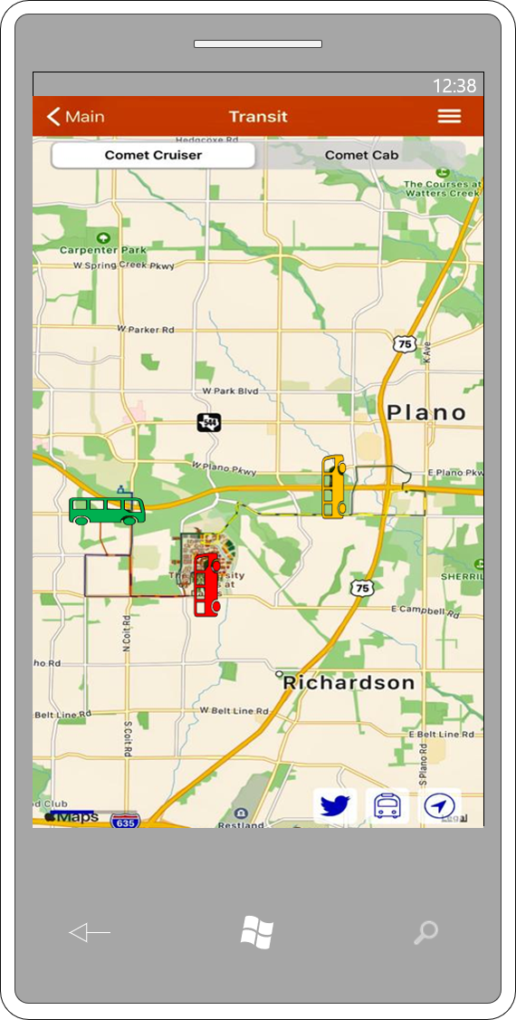
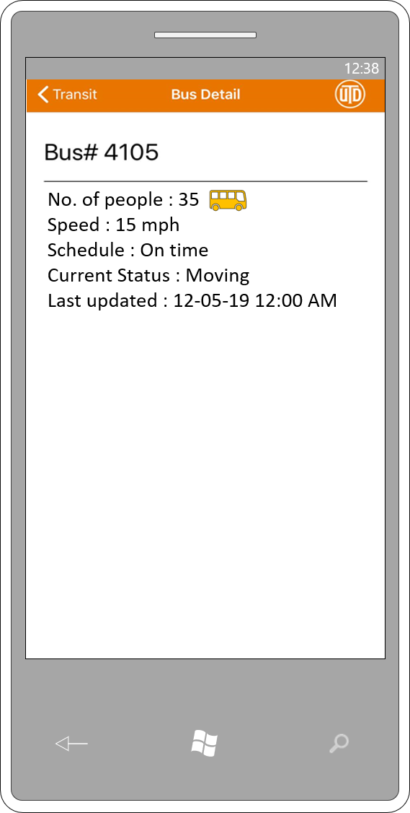
Interface

Slide 9
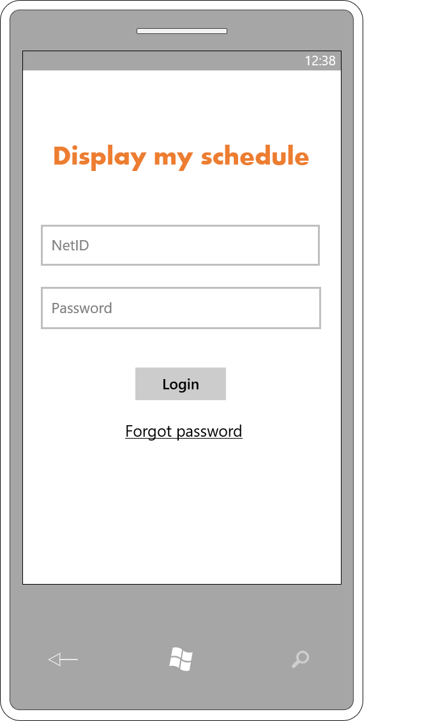
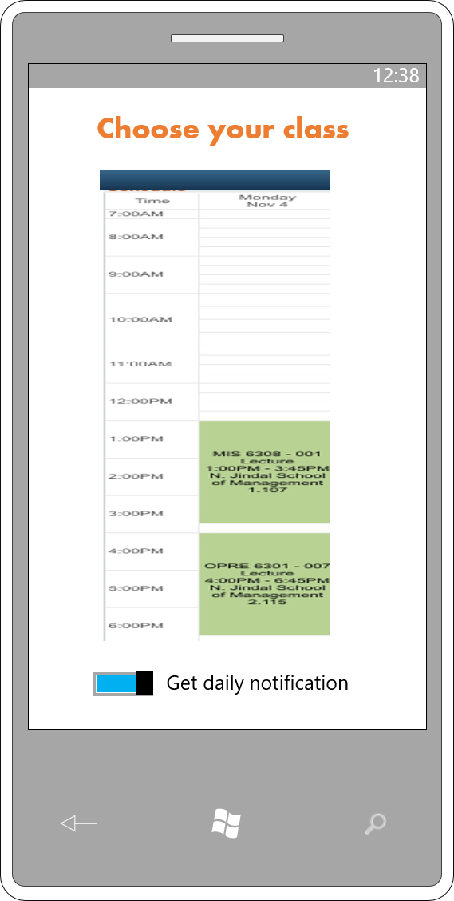
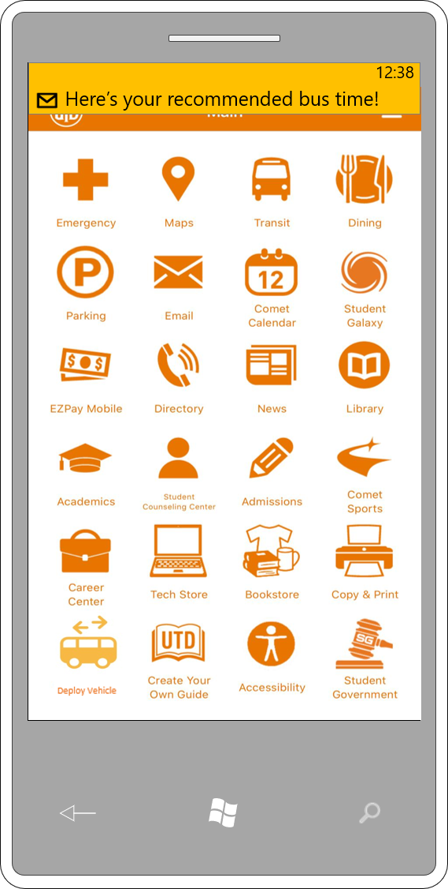
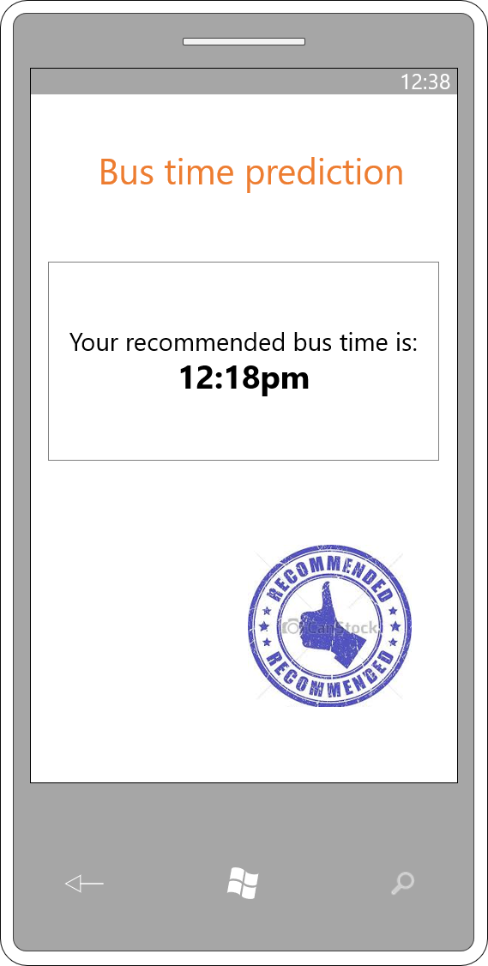
Interface

Slide 10
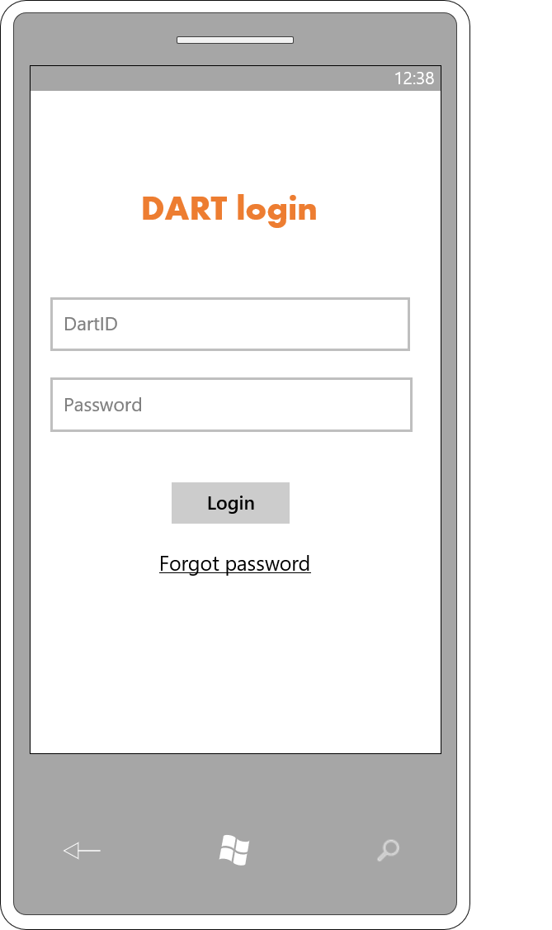
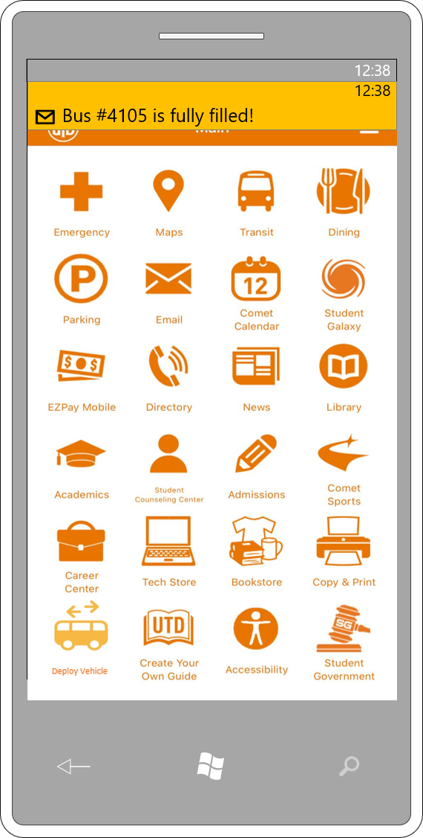
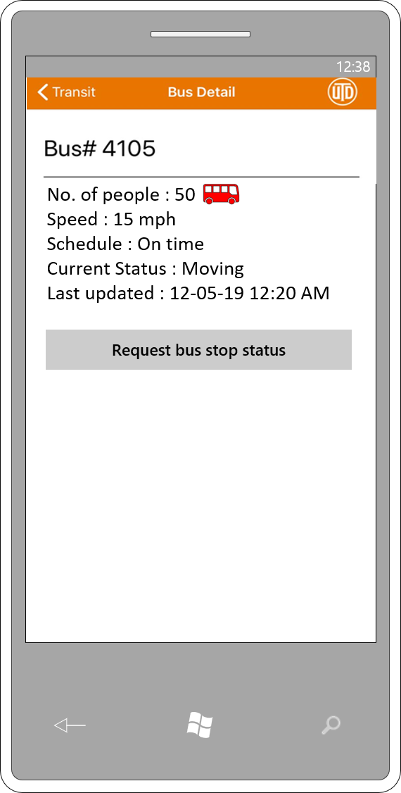
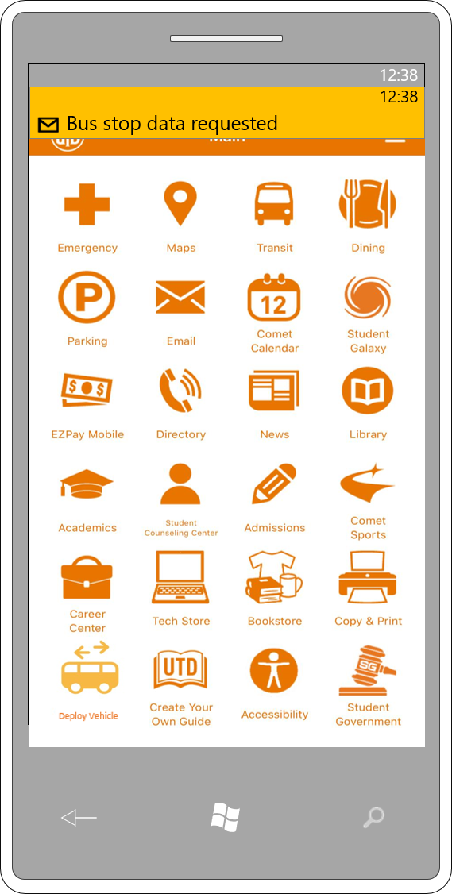
Interface

Slide 11
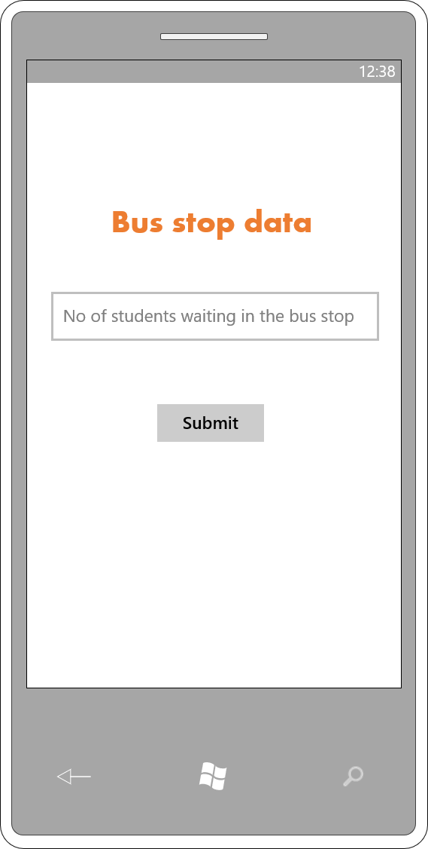
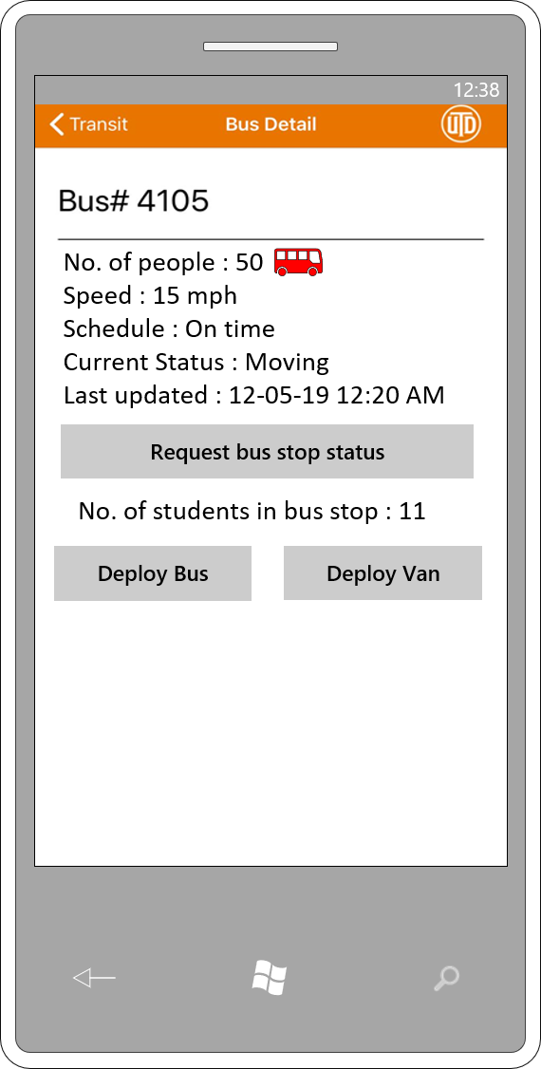
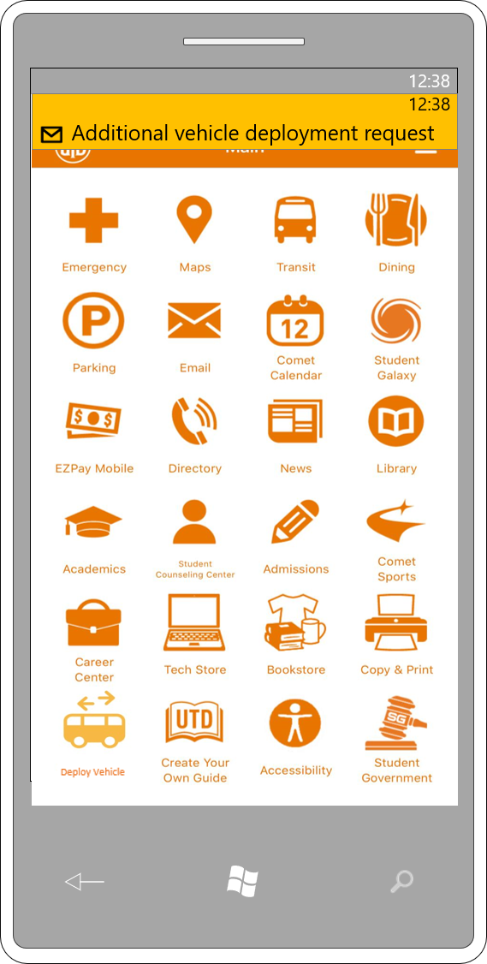
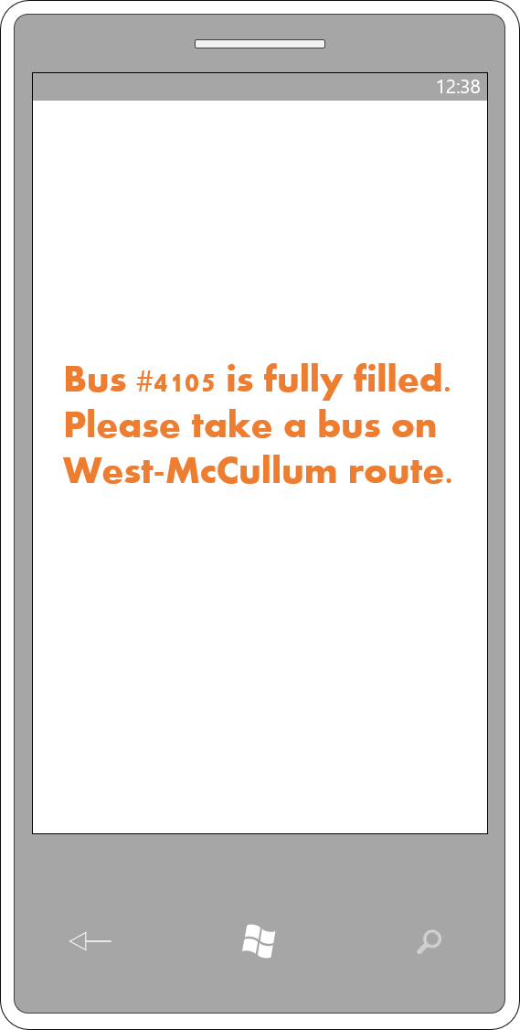
Interface

Slide 12
Future Enhancements
Install sensors at major bus stops to automate the crowd density check process
Improve the system by predicting bus part failures. This will avoid any bus breakdowns.
Improve transit management interface for UTD Dart Officials by creating a standalone app

